Slide 1
Honours Leadership and Innovation
Lester Rietveld, Fred Wollerich & Jacqueline Randall
13th November 2018

Slide 2


Slide 3
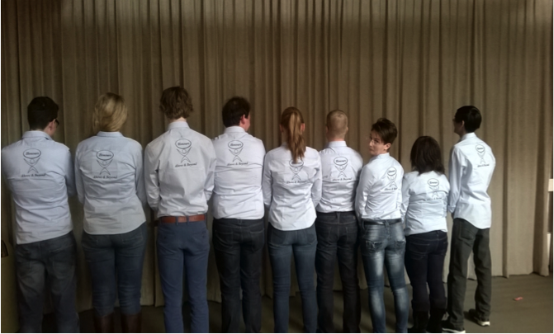
How we started!

Slide 4
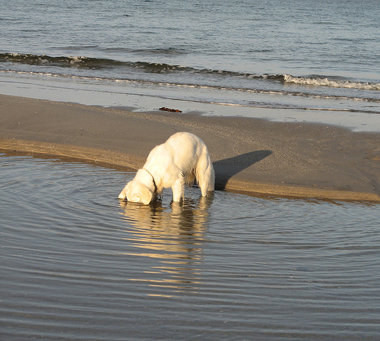
Are you looking for?
Developing your talents?
Broadening your horizons?
Identifying and exploring new skills?
Creating your future?
Challenges?
Excellence?
Inspiration?
Leadership?

Slide 5
What will you gain?
Empowerment
Humour
Intellectual, social and emotional challenges
Personal development
Inspiration
Drive to achieve your full potential
Co-create your future
Working in a diverse team
Insight into self
Expect the unexpected …

Slide 6
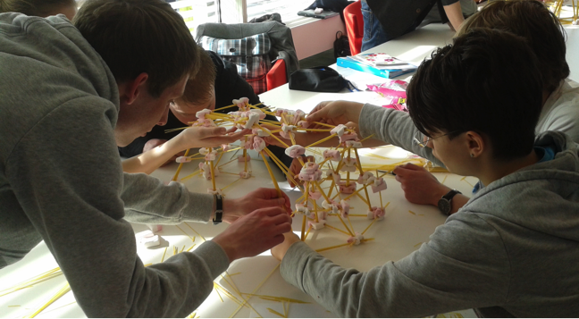
Creativity

Slide 7

What is expected from you?
Commitment
Courage
Supportive
Self-reflection
Honesty
Enthusiasm/eager to learn
Pro-active and responsible attitude

Slide 8
Key characteristics
Integral part of Honours community – you build your sub-community
Multi-disciplinary
Multi-cultural
Leadership from inside-out
Social awareness and responsibility
Innovation
Personal development

Slide 9
Indicative content
1
Semester 1: February – June 2019
LEADING SELF
Habits of effective
leadership (Covey)
Personal leadership
Entrepreneurial skills
Self-responsibility
Coaching
Coaching with dogs
LEADING OTHERS
Personal Leadership –interdependence
Flexibility & creativity
Business skills
Teamwork
Bootcamp weekend
Personal insights

Slide 10
Indicative content contd.
1
Semesters 2 and 3
Product Innovation
Intercultural management
Insights – Discovery Profile
Leadership and The Right Use of Power©

Slide 11
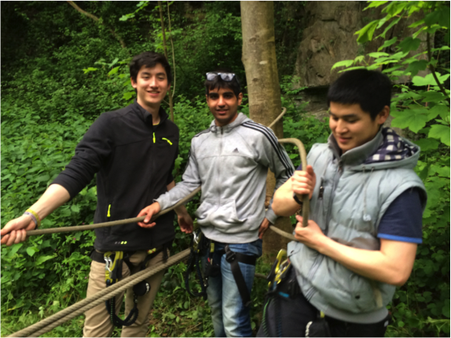
Ardenne

Slide 12
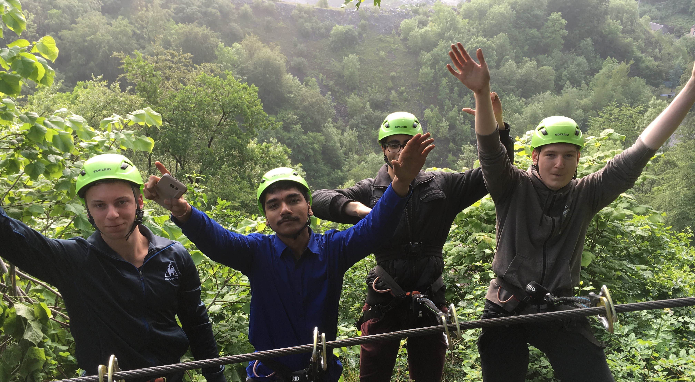
Ardenne

Slide 13
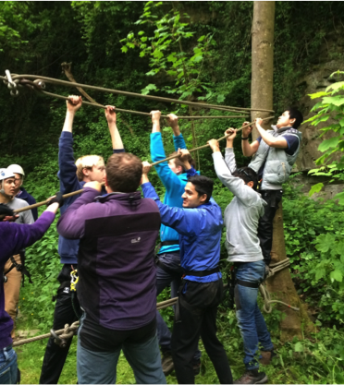
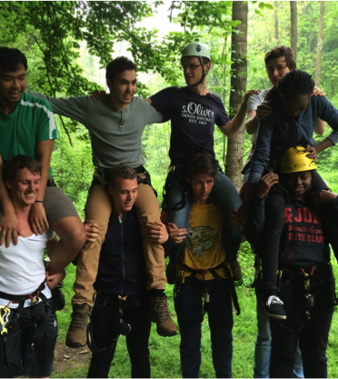
Ardenne

Slide 14
Organisation
2 year programme – 3 semesters (February 2019 – February 2021)
Every Wednesday morning/afternoon
Kick-off - Masterclasses/Bootcamp
18 EC’s
Additional to regular degree
Assessment
Attendance and active participation

Slide 15
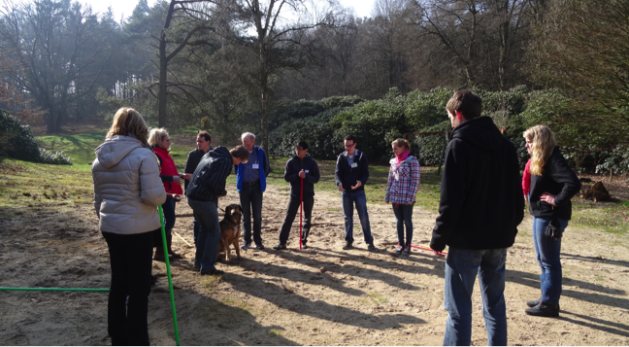
Coaching with dogs

Slide 16
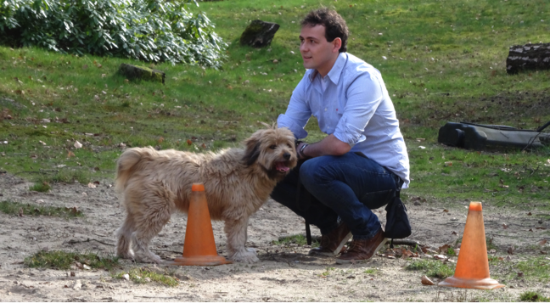
Coaching with dogs

Slide 17
Programme – 3 semesters
 | Term 1 | Term 2 | Term 3 | Term 4
Year 1 | Regular study | Regular study | Regular study | Regular study
Year 2 | Regular study/ Practical internship | Regular study/ Practical internship | Regular study Honours | Regular study Honours
Year 3 | Regular study/Internship | Regular study/Internship | Regular study Honours | Regular study Honours
Year 4 | Regular study Honours | Regular study Honours | Regular study/ Graduation | Regular study/Graduation

Slide 18
Timeline
Sign up now!!!
Friday 30th November 2018 – submit application (see next slide)
10th – 18th December 2018
If successful you will be invited for a personal
interview

Slide 19
Grab this opportunity!
Send your (as one package):
CV
Motivation letter
Grade list from 1st year
2 letters of recommendation – external to Inholland
To:
Jacqueline.Randall@inholland.nl and
HonoursEDC@inholland.nl
By Friday 30th November 2018 at the latest

Slide 20
“Excellence is never an accident. It is always the result of high intention, sincere effort and intelligent execution; it represents the wise choice of many alternatives – choice, not chance, determines your destiny.”
Aristotle

